Slide 1
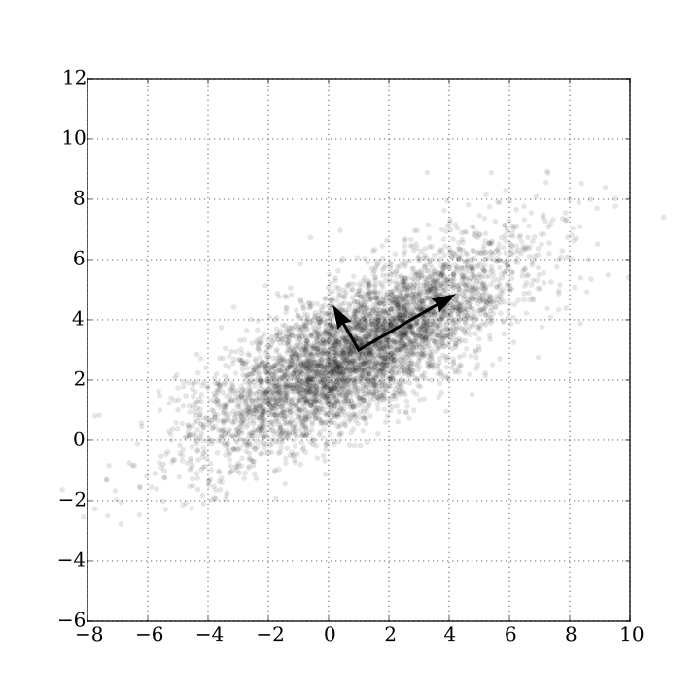
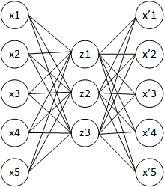
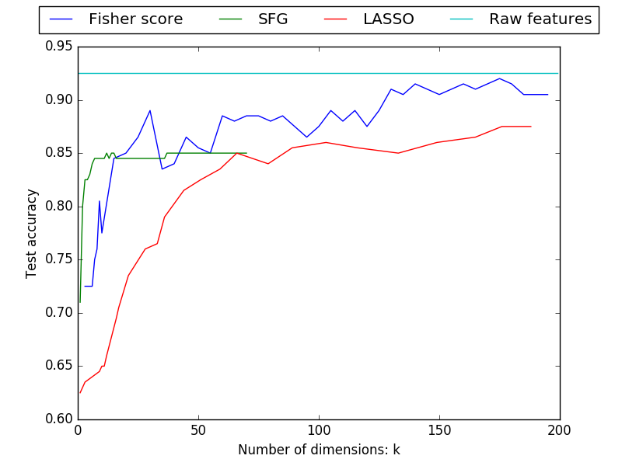
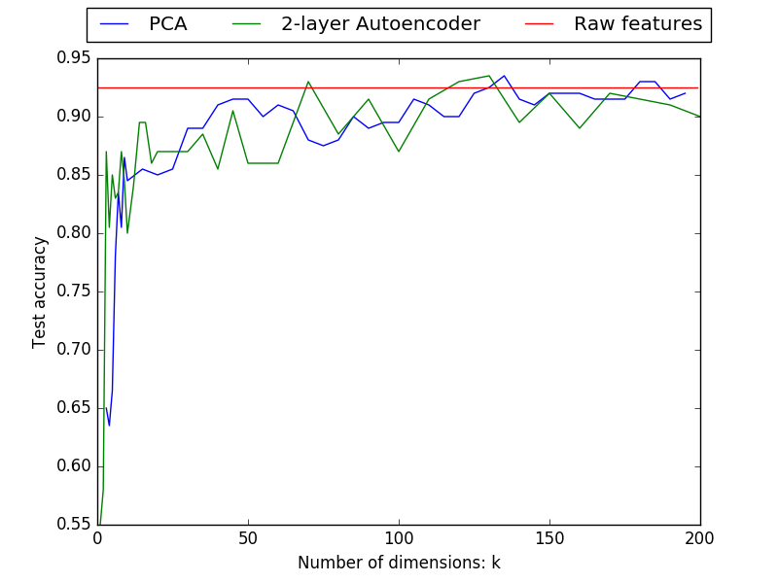
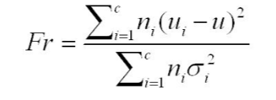
Feature Selection and Extraction for Noisy Features
Yuqing Ai Jingchen Hu
Introduction
Feature selection and extraction (often referred as dimension reduction) are important preprocessing steps for machine learning tasks. These steps help reduce overfitting and enhance generalization by filtering / reconstructing the features to reduce the effects of irrelevant variables. In the meantime, they also reduce the feature space and make large scale training more efficient in face of the Curse of Dimensionality. In this project, we study a variety of feature selection and extraction algorithms.
Experiment Setup
The Dataset
We use the Dexter dataset (http://archive.ics.uci.edu/ml/datasets/Dexter) which was first used in a feature selection competition in NIPS 2003 workshop. Dexter is a binary text classification task given bag-of-word counts. The feature values are sparse integers following a Zipf’s distribution.
This dataset contains a lot of noisy and irrelevant features (probes) intentionally added to make training harder:
Real variables Random probes Total features
9947 10053 20000
We re-partition the available dataset into:
Training Validation Testing
300 100 200
Our goal is to train a more compact feature representation that preserves the most relevant feature information.
The Classifier
We use a C-SVM (with C = 1) in the LIBSVM library to solve the final classification task after the different initial feature selection / extraction phases presented below. Using all the raw features in the dataset, this classifier achieves a 92.5% test set accuracy.
Methods
Feature Selection
Feature selection aims to select a subset of the original feature set. There are 3 general classes of algorithms, and we implement one in each class.
Filter-based methods: select all the features used as a pre-processing step prior to the learning algorithm.
Fisher Score: Scoring the features based on the
distribution of the data on that feature. We want
the distances between data points in different
classes to be large, while the distances between
data points in the same class to be small.
Wrapper-based methods: score and reselect the features by repeatedly applying a blackbox learning algorithm that will ultimately be employed.
SFG (Sequential Forward Generation) / Hill climbing: Start from an empty feature set, greedily keep adding the “next best” feature in terms of increased accuracy on the training set.
Embedded methods combine feature selection with the learning algorithm. The design of embedded method is tightly coupled with a specific learning algorithm, which in turn limits its application to other learning algorithms.
LASSO regression: use L1 norm regularization to force the weight vector to be sparse.
Feature Extraction
Feature extraction builds a new set of features from the original feature set that captures the key information.
PCA (Principal Component Analysis):
Projecting the data onto a low dimensional
subspace that preserves most of the variance.
Autoencoder : Feed-forward neural network try to learn function where output is the same as the input. The encoding complexity constraints are imposed by the “bottleneck” hidden layer in the network.
In our construction we use a 2-layer neural net, with Relu and Sigmoid as the two activation functions, squared loss as the cost function, and early stop as regularization. The training is done using the same back propagation algorithm: we run 100 epochs using SGD with batch size 20. Although our own implementation works fine, we use the Theano framework for better performance in this experiment.
Results
Methods Comparison
Conclusions
Overall feature extraction methods outperform feature selections methods.
The results of feature selection preserve structure property, and have better interpretability and informing intuition. (we can inspect the specific bags of words).
We can see that using feature extraction, we can achieve higher test accuracies than using all the raw features. Therefore, if done correctly, dimension reduction can help increase performance.
It’s useful to normalize the high-variance data before doing feature extraction.
Directions for further study:
Sparse autoencoder; Data independent methods for online learning, etc.
 | Pros | Cons
Fisher Score (Filter based) | Computationally simple and fast. Compatible with different classifiers once computed. | Ignore the interaction with the classifier and feature dependencies.
SFG (Wrapper based) | High performance for first few dimensions. | Time consuming. Higher risk of overfitting. Not scalable. No feature dependencies.
Lasso (Embedded method) | No need for manually selecting the number of features (controlled by λ). | Specific to a single learning machine.
PCA | Fast, ubiquitous, and high performance. | Cannot model non-linear structure. “Structure of data” is lost.
Autoencoder | Introduces nonlinearity, which makes it more general than PCA. | More hyperparameters to tune compared to PCA. Easy to overfit. “Structure of data” is lost.

